Slide 1




DIGITAL
WORKFLOW SOLUTION
How to turn your process into digital workflows and automate it
BBK TRADE ONBOARDING AUTOMATION
Version 2
BY

Slide 2


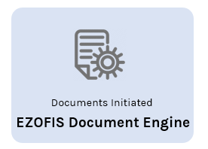





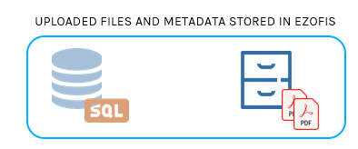
Unprocessed Files will be moved to Unprocessed folder if any mandatory metadata / file missing on API (if Base64 received fully)
BBK: Screen to browse / upload the files
BBK: Call EZOFIS API to Push / Upload Files [as JSON Param]
EZOFIS
API
Single Login – TOKENs (generated with an separate login + Password will be shared to BBK (To Secure API Calling)) Per day- Token Generated
Metadata should be encrypted with the above code & Token before passing the value in EZOFIS API
Single File should be passed via Base64 on each API CALL
If RIM Number / TIN Number has the KYC Files in Retail
No
Yes
Successfully Archiving into EZOFIS Portal for the PDF/A Files as final (for Corporate Repository – for KYC Files)
Successfully Archiving into EZOFIS Portal for the PDF/A Files as final (for Corporate Repository – for KYC Files)
Verifies in Retail, for the same RIM Number / TIN Number whether the KYC Files are there.
If yes, copy the new file under the Retail Repository as New Version
API Flow: BBK PORTAL (Corporate)

Slide 3
REPOSITORY | BBK
Template | Corporate
Document Upload | VIA API
INDEXING FIELDS | DATA TYPE | HIERARCHY | Sample Values
RIM Number * | (Text Area) | Folder 1 | 12345678
RIM Name * | (Text Area) |  | Invita Company B.S.C.
RIM Type * | (Chosen) | Folder 3 | Non Personal (Personal / NON Personal)
RIM Branch * | (Chosen) |  | Main Branch (BBK Masters)
TIN Number * | (Text Area) | Folder 2 | 59340-1
LAST KYC DATE * | (Date)
Document Type * | (Chosen) | Filename | Articles (Compliance, RIM Details, Deposit, Other) (BBK Masters)
Account Number | (Text Area) |  | 100000593401
Quality Check | (Chosen) |  | Yes (Yes / No)
File Location | (Text Area)
Mandate Type | (Chosen) |  | VIP (Staff / VIP / Normal)
File Status | (Chosen) |  | Original received (Original File Not Received Original File Received)
Account Type | (Chosen) |  | (SCM / LMS / CMZ / FFD / CSC / SHR / CUR / SSV / CNS / SMM / LSR / PIL / SSM / FTD / SCL / SAV)
Account Status | (Chosen) |  | Active (Active / Close)
HIREARCHY | BBK / Corporate / RIM Number / TIN Number / RIM Type / Document Type.pdf BBK / Corporate / 10000004 / 9840 / NON Personal / other_010922.pdf BBK / Corporate / 10000004 / 9840 / NON Personal / Other_010922_1.pdf BBK / Corporate / 10000004 / 9840 / NON Personal / Other_020922.pdf
Version : Compliance_01092022_1
Compliance_01092022_2
Compliance_10092022_3
Deposit_01092022_1
Other_10092022_1
Corporate: Metadata(Info)

Slide 4
UPLOAD API: Used to upload the file into the repository at eachtime into the EDMS System
API : Looks only for the Metadata which is mandates to store / archive the folder & file in the centralized BBK Storage
Input Format: JSON + Base 64 (FILE) (with RIM Details)
Mandates:
RIM Number/ RIM Name / RIM Type/RIM Branch/TIN Number/Last KYC Date / Account Number /DOCUMENT Type
Folder Hierarchy : BBK / Corporate / RIM Number / TIN Number / RIM Type / Document Type.pdf
Repository: Corporate
Each File -> Each API Call

Slide 5
API.1
EZOFIS API – 1
FILE UPLOAD WITH METDATA
[Metadata: JSON
PDF as BASE64]
Input JSON | Response Body
{ "CabinetName": “Corporate", "file" :"", "filetype": "pdf", "Fields": [ { "FieldName": "RIM Number ", "FieldValue": "10627245" },{ "FieldName": "RIM Name", "FieldValue": "FADHEL ALMUDHAWI“ },{ "FieldName": "RIM Type", "FieldValue": "Personal" },{ "FieldName": "RIM Branch", "FieldValue": "BBK - Lite Hidd - 205"},{ "FieldName": "TIN Number", "FieldValue": "830707859" },{ "FieldName": "LAST KYC DATE", "FieldValue": "28-Aug-2022" },{ "FieldName": "Document Type", "FieldValue": "Deposit" },{ "FieldName": "Account Number", "FieldValue": "200007615777" },{ "FieldName": "Quality Check", "FieldValue": "NO" },{ "FieldName": "File Location", "FieldValue": "C84565" },{ "FieldName": "Mandate Type", "FieldValue": "Normal"}, { "FieldName": "File Status", "FieldValue": "Original File Received"},{ "FieldName": "Account Type", "FieldValue": "Salary Transfer" },{ "FieldName": "Account Status", "FieldValue": "Active" }} | Response Code : 200 Response Body : “Successfully Archived” [Note : For Client Error 400 Bad Request 401 Unauthorized 404 Not Found 406 Not Acceptable For Server Error 500 Internal Server Error]
Single File
Repository: Corporate
UPLOAD API: Used to upload the file into this repository at eachtime into
the EDMS System
API : Looks only for the Metadata which is mandates to create the folder & file
Input Format: JSON + Base 64 (FILE) (with Job Details)
NOTE: Uploading the files can be done at anytime from the BBK Portal

Slide 6
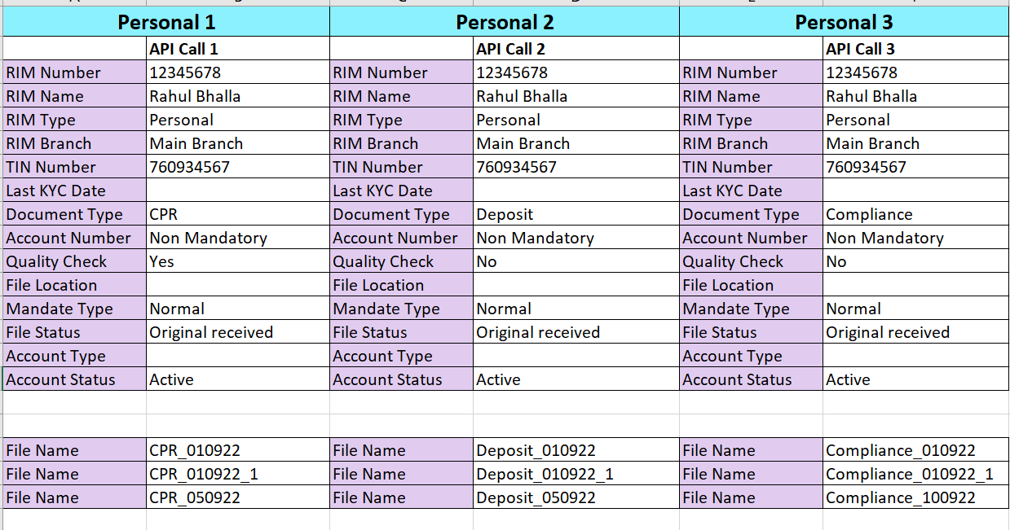
Corporate: Test Case
On the API Call, system will store the documents in Corporate and Retail as well

Slide 7
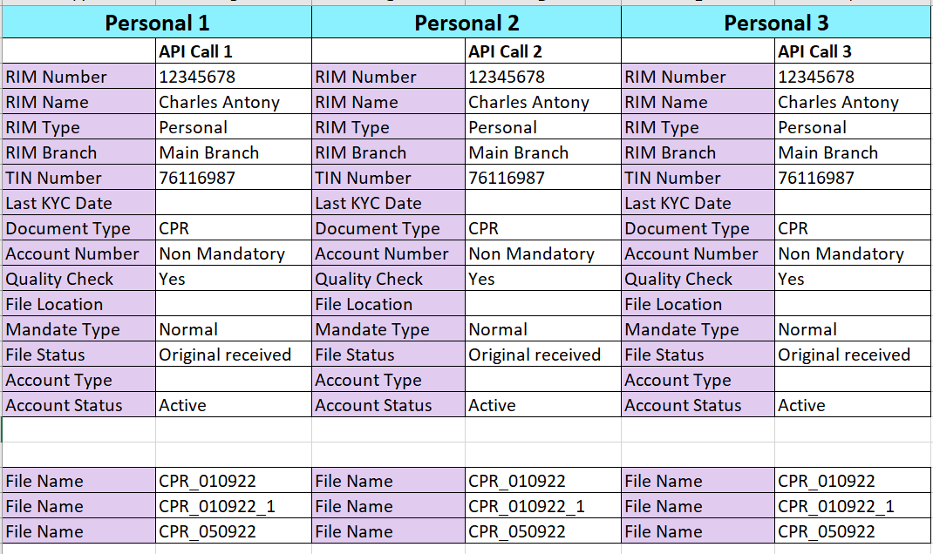
Corporate: Test Case
On the API Call, system will store the documents in Corporate and Retail as well

Slide 8
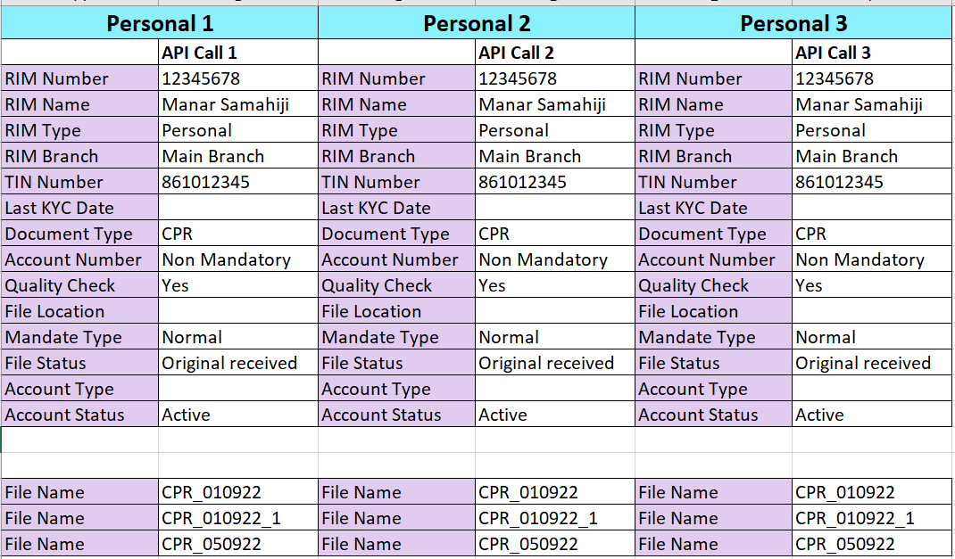
Corporate: Test Case
On the API Call, system will store the documents in Corporate and Retail as well

Slide 9
Thank You

